Slide 1
Travel Attractions Database
Yong Chen
Nicholas Luu
Gurbir Kalsi

Slide 2
Introduction
Databases model information and relationships that are represented in the real world.
In this case, we pursued the model of representing travel attraction listings for different cities.
Main relationships to keep track of:
City
Hotels
Tours
Reviews
Customers

Slide 3
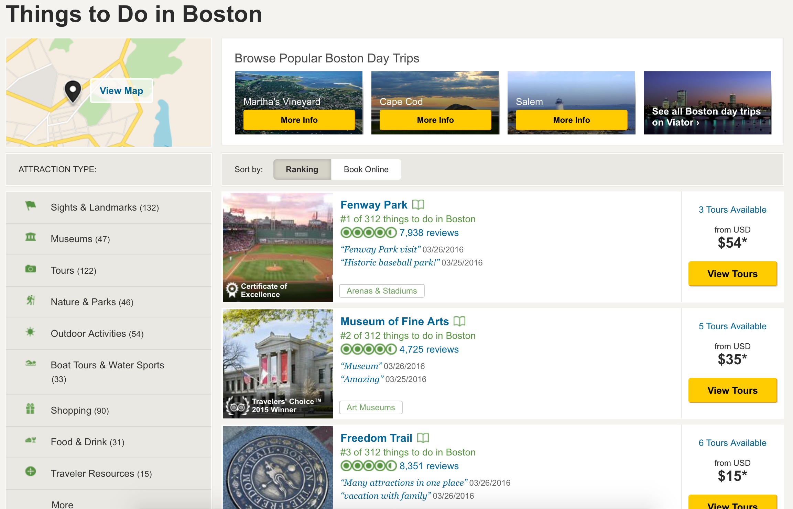

Slide 4
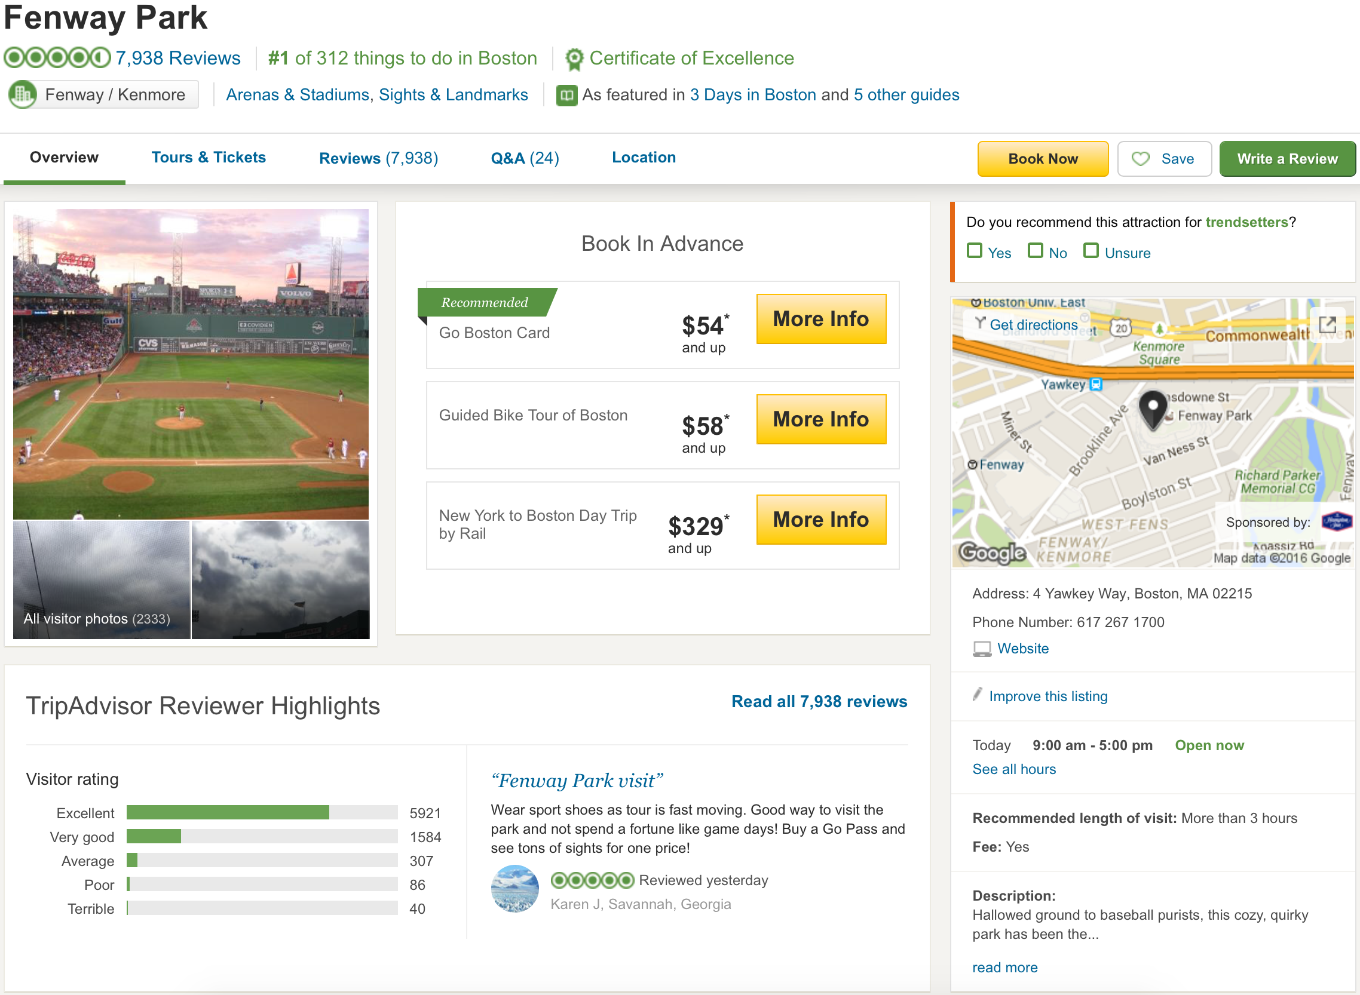

Slide 5
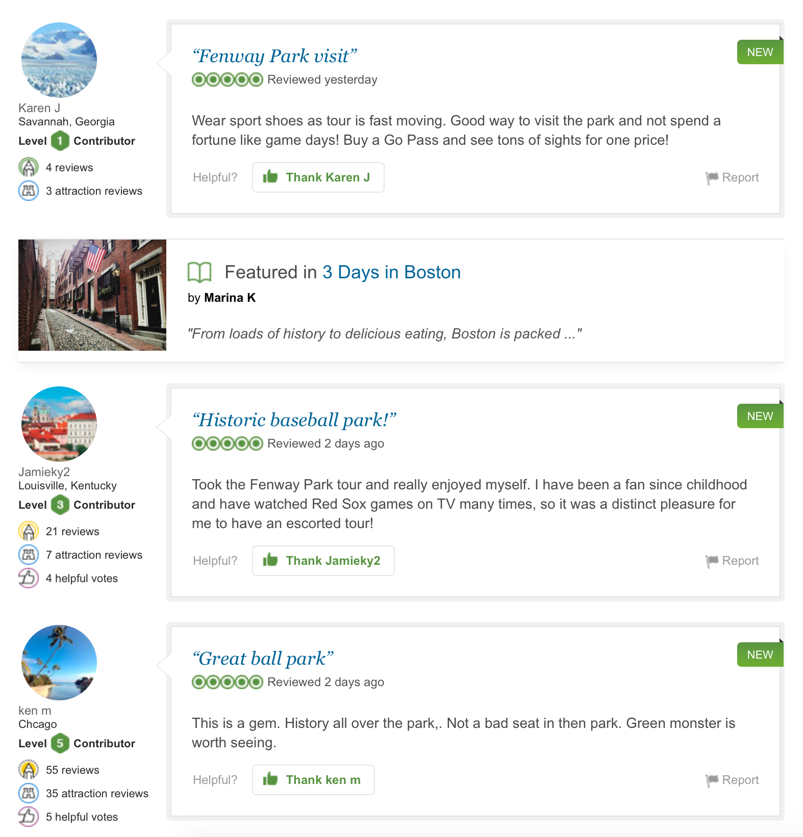

Slide 6
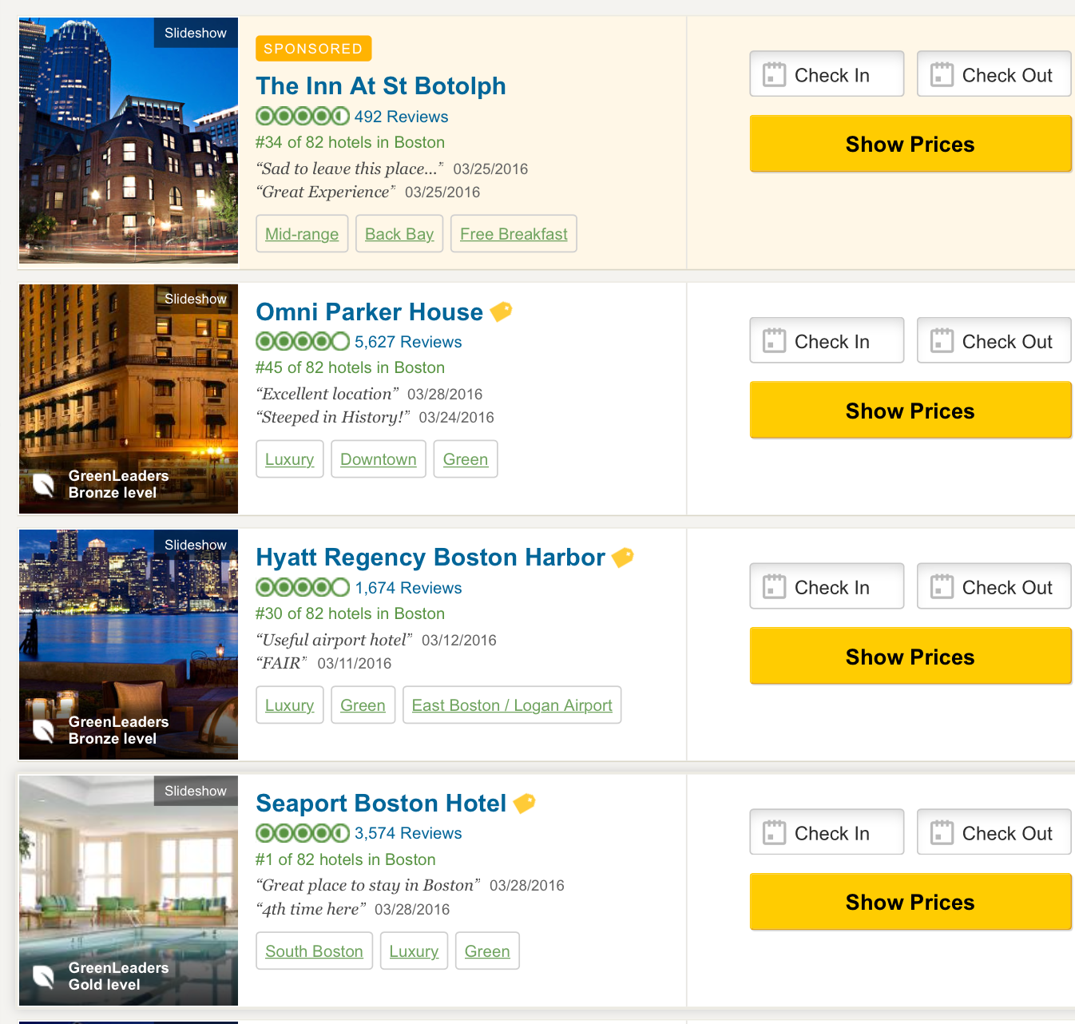

Slide 7
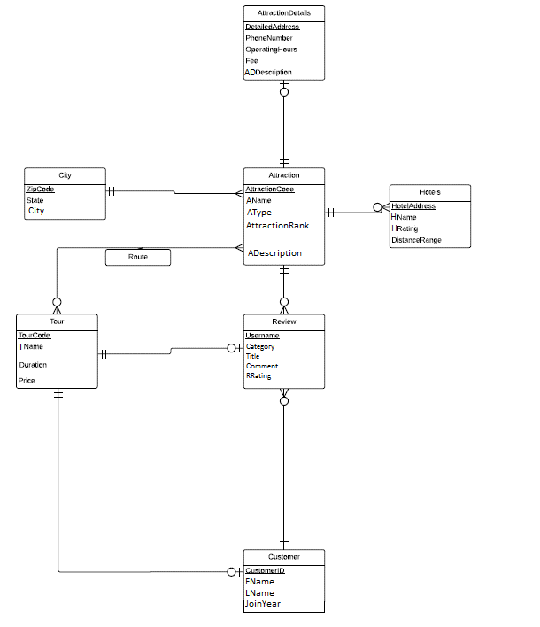

Slide 8
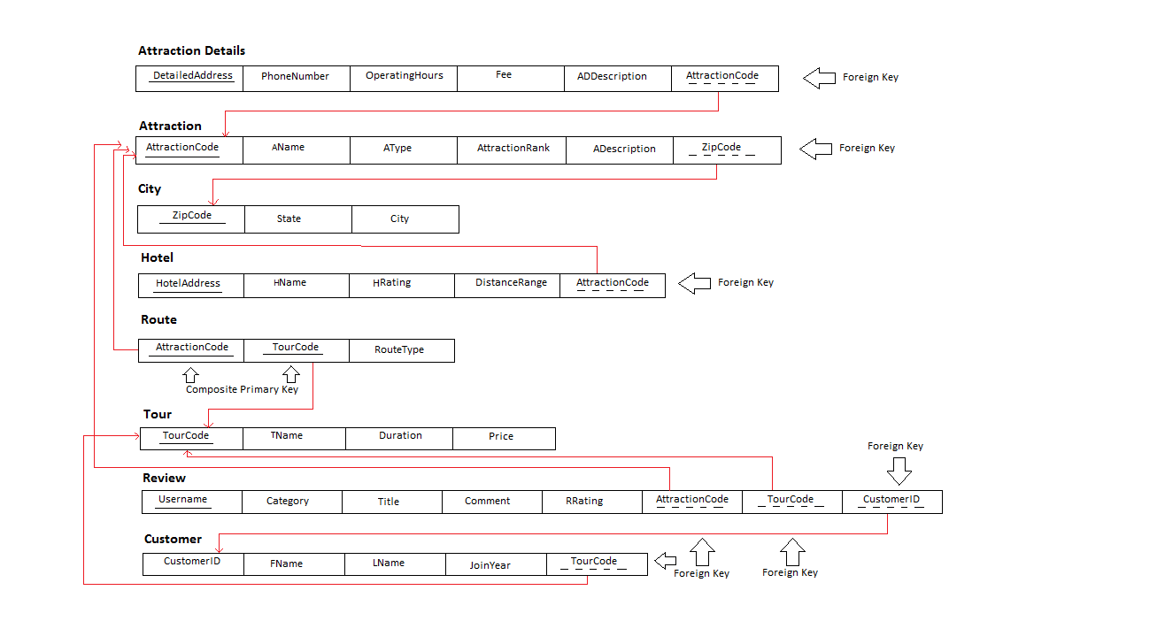

Slide 9
Create Order: City → Attraction → AttractionDetail → Hotel → Tour → Customer → Review → Route
Drop Order: Route → Review → Customer → Tour → Hotel → AttractionDetail → Attraction → City
Route is a relation.

Slide 10
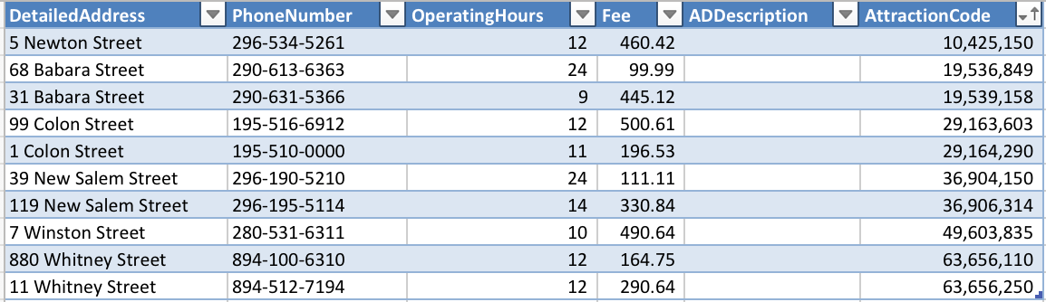
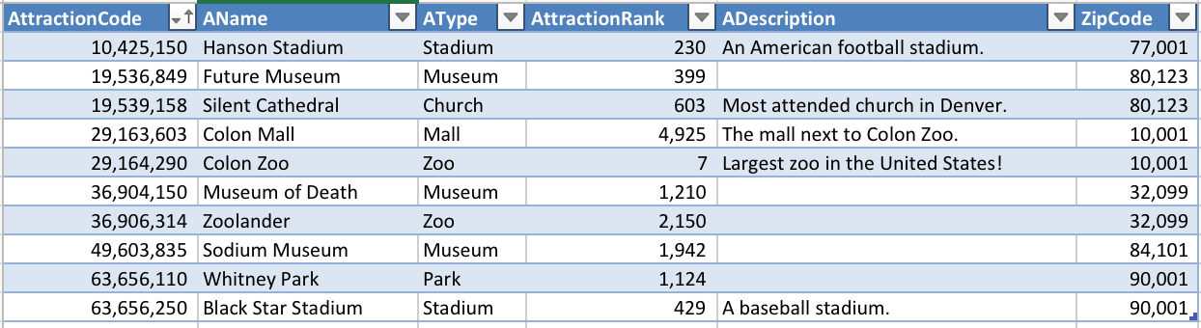
AttractionDetail
Attraction

Slide 11
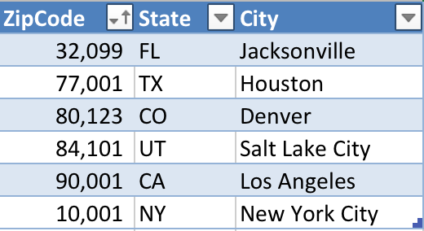
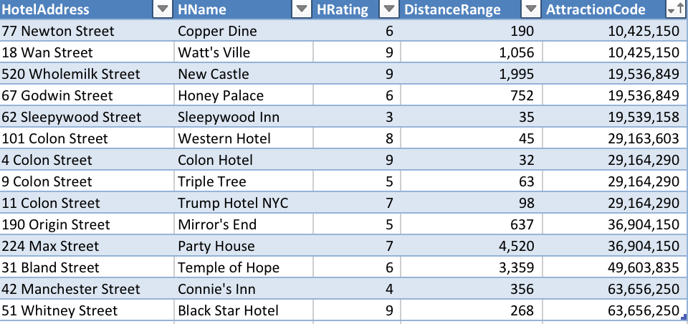
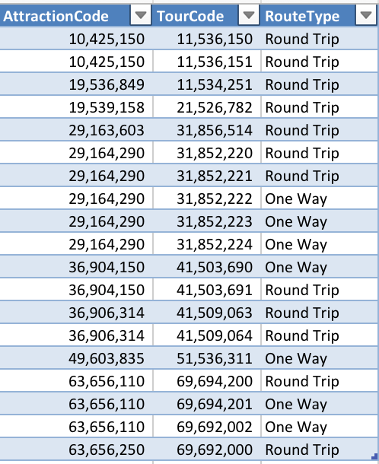
City
Hotel
Route

Slide 12
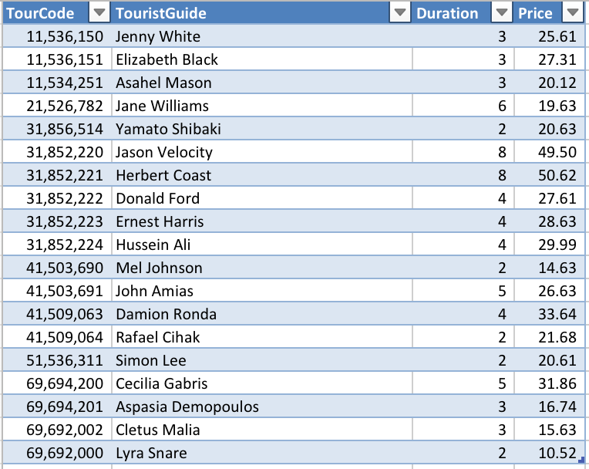
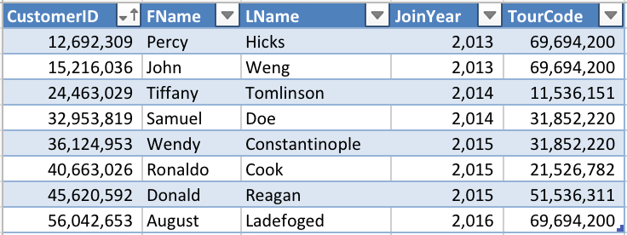
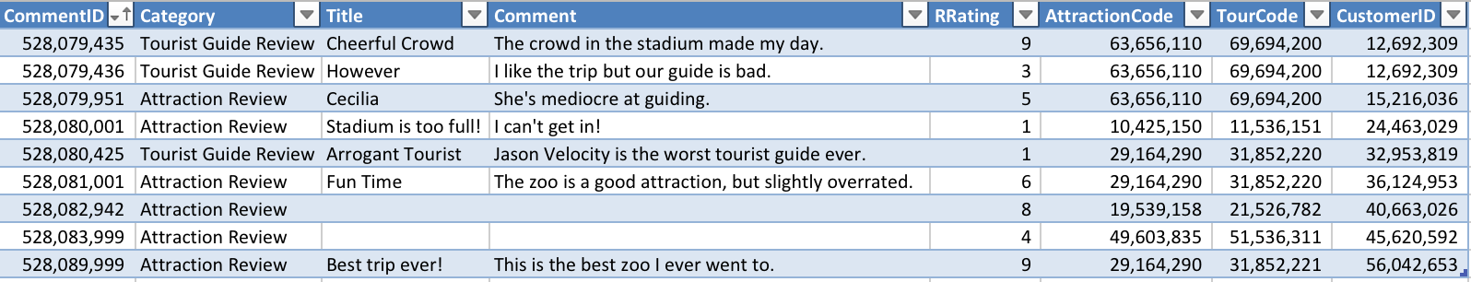
Tour
Customer
Review

Slide 13
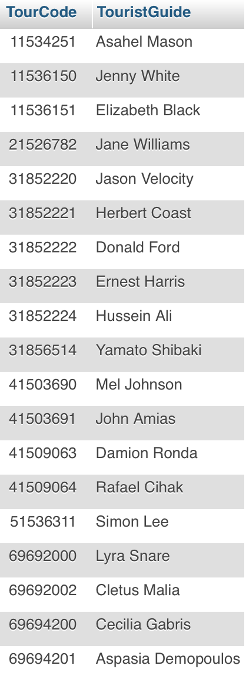
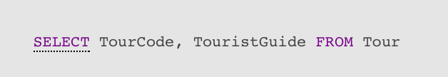
Chapter 6 – Query 1
Displays two columns from table Tour.

Slide 14
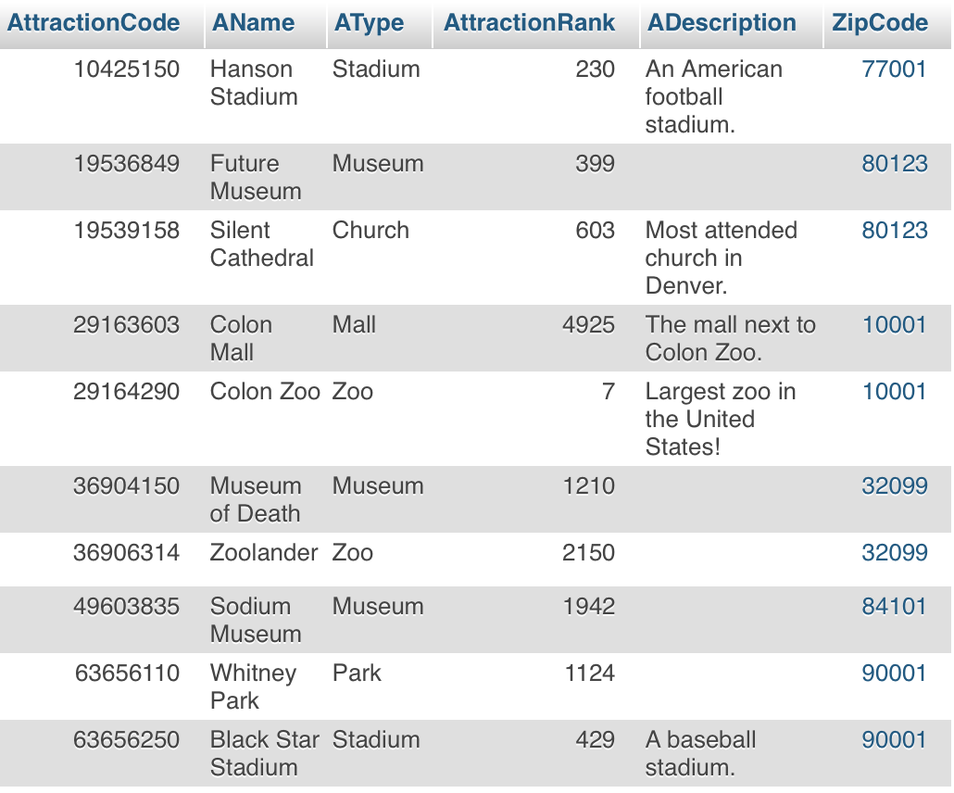
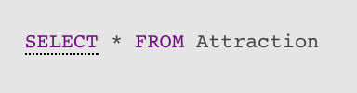
Chapter 6 – Query 2
Displays all columns from table Attraction.

Slide 15
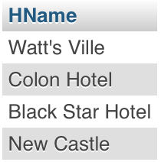
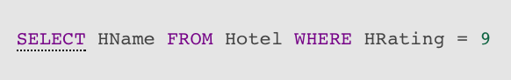
Chapter 6 – Query 3
Display all hotel names with the rating of 9

Slide 16
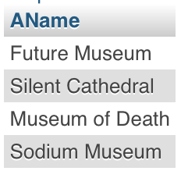
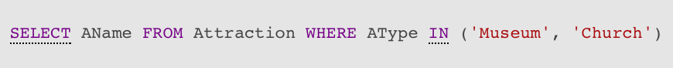
Chapter 6 – Query 4
Display all attractions that are museums or churches.

Slide 17
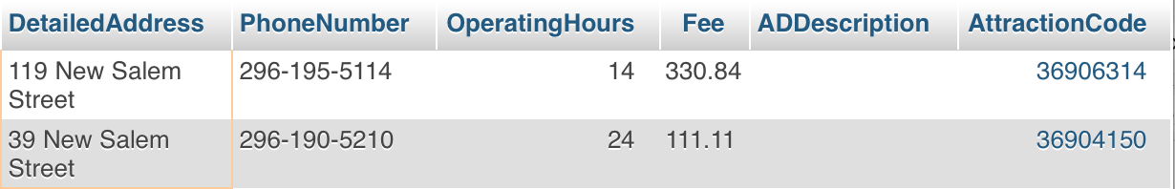
Chapter 6 – Query 5
Display all columns from AttractionDetails that are in New Salem Street.

Slide 18
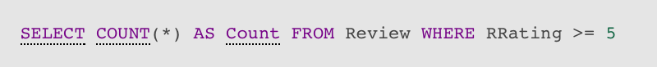
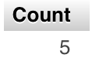
Chapter 7 – Query 1
Count the reviews that have the rating of 5 or above.

Slide 19
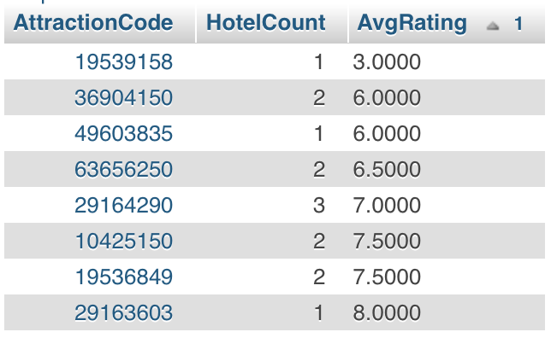
Chapter 7 – Query 2
Find number of hotel in each attraction (based on attraction code),
and average rating for each attraction's nearby hotels.

Slide 20
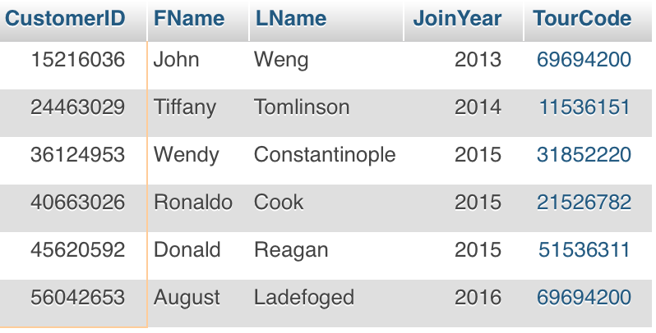
Chapter 7 – Query 3
List all the customers that wrote an attraction review based on customerID.

Slide 21
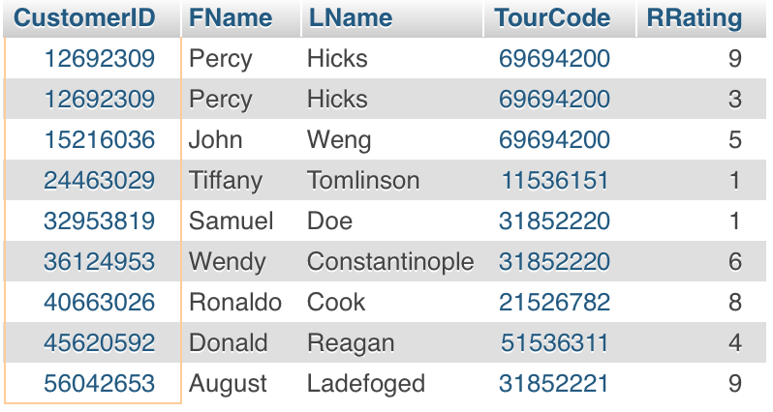
Chapter 8 – Query 1
List CustomerID with Name on the Review table if it is matching with Customer table.

Slide 22
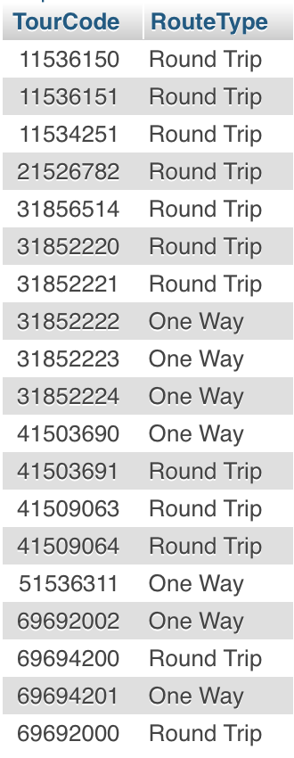
Chapter 8 – Query 2
Show the TourCode and RouteType of the Route table if there is a match between Route and Tour table

Slide 23
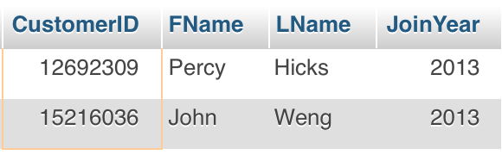
Chapter 8 – Query 3
Find the customers that has the tour code of 69694200.

